Slide 1

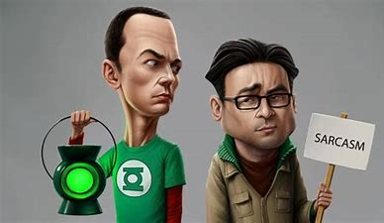
Sarcasm Detection
Submitted By:
Shaurya Negi
Reshma Madhavankutty
Rishab Mahajan
Krish shah
Kunal Dubey

Slide 2
Contents
Problem Statement​
Dataset Description​
Exploratory Data Analysis​
Data Pre-Processing
Machine Learning Modeling
Deep Learning Modeling
Results

Slide 3

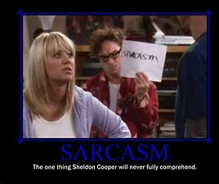
Introduction
To generate freshness in the dataset selection for Natural Language Processing which is generally centered to Tweets form Twitter website.
On exploring dataset we came across this dataset which captured our attention like moth to a flame.
Identifying Sarcasm is challenging task even for smartest individuals and we wanted to see how machines will fare in detecting sarcasm.

Slide 4
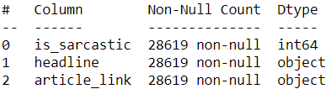
Dataset
The dataset includes Headlines from two news website :
The Onion aims at producing sarcastic versions of current events
Real (and non-sarcastic) news headlines from HuffPost
On basic Data Exploration, we observed:
Dataset has no duplicates
No null values in the dataset

Slide 5
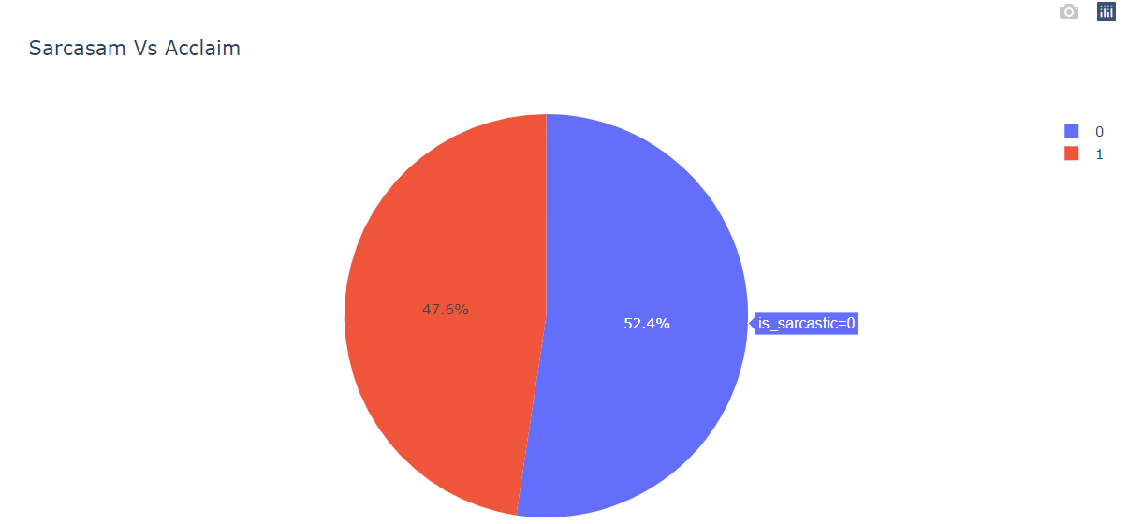
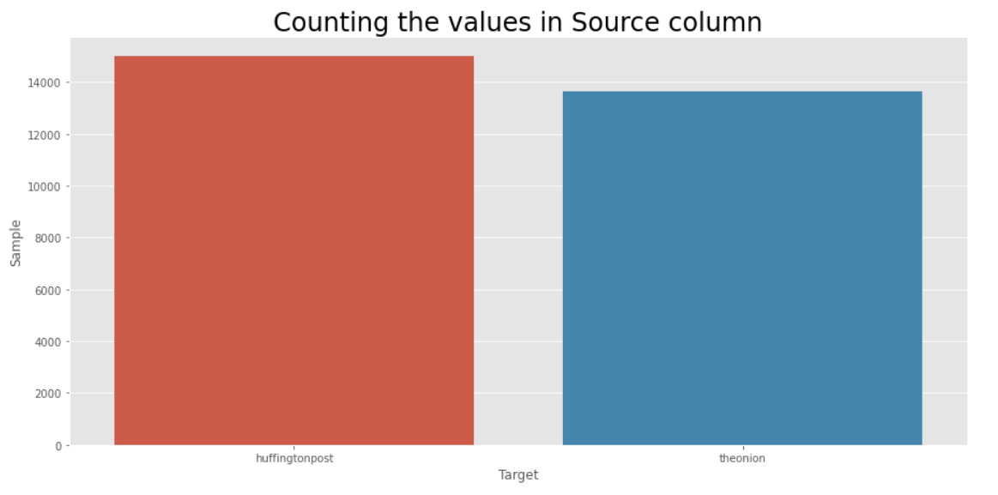
Exploratory Data Analysis
As a basic exploration, we visualize the types of words that occur frequently in each category through Bar Charts, World Clouds etc

Slide 6
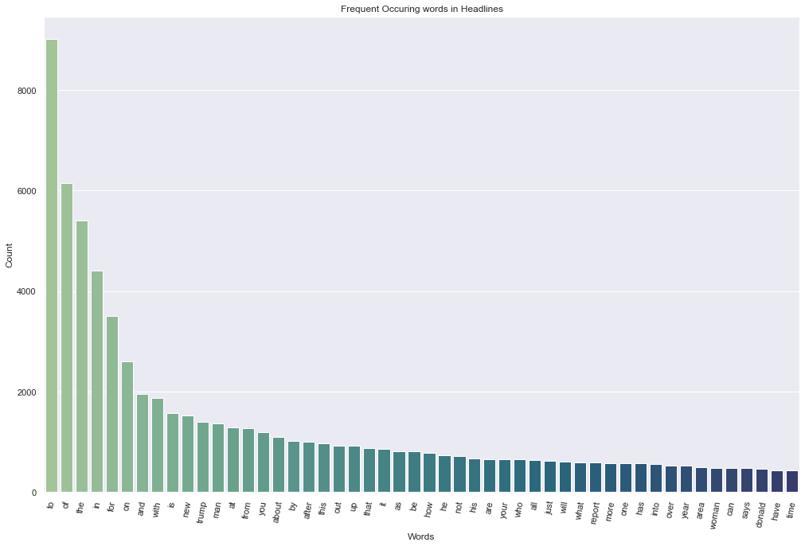
Frequency of words for whole Dataset

Slide 7
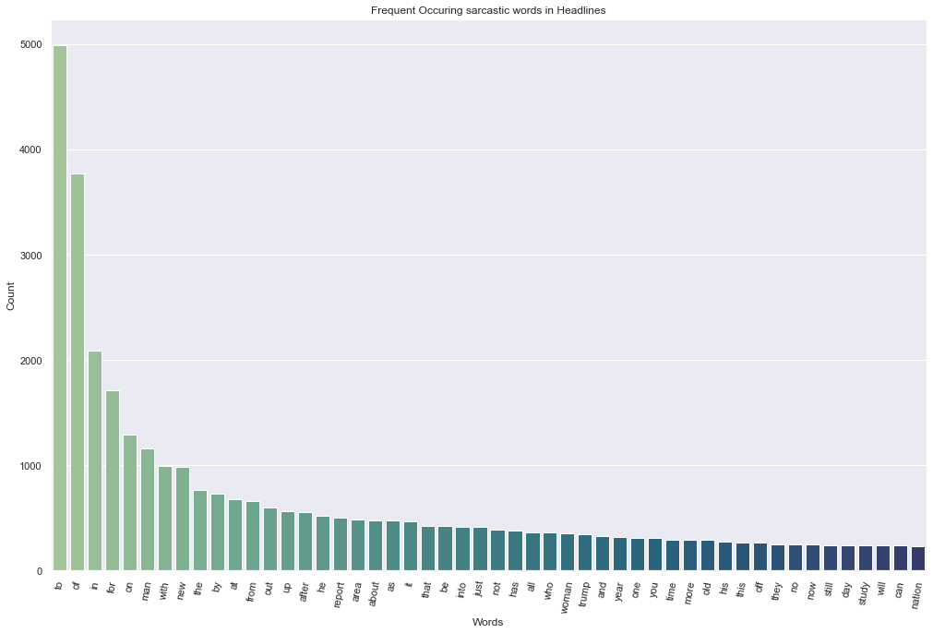
Frequency of words for Sarcastic Headlines

Slide 8
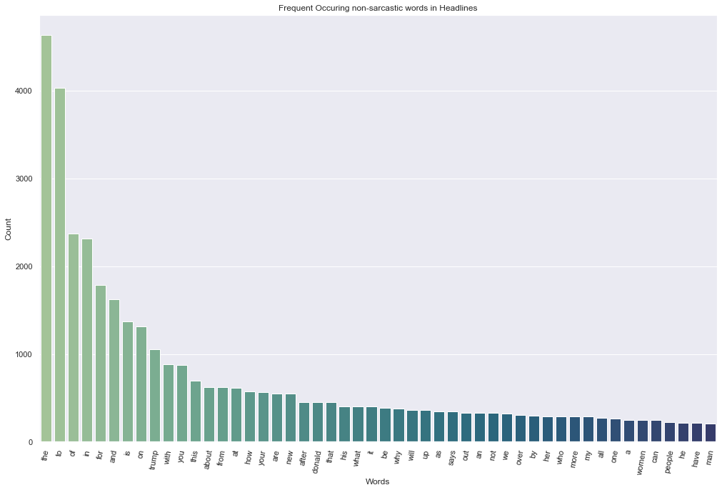
Frequency of words for Non-Sarcastic Headlines

Slide 9
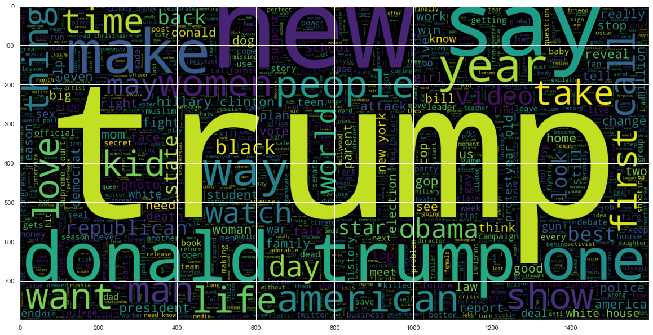
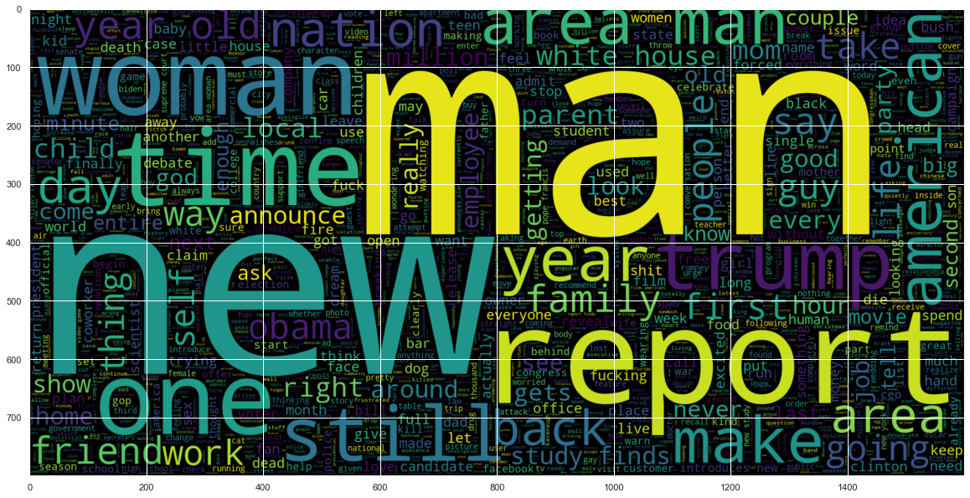
Word Clouds
World Cloud for Non-Sarcastic Headlines
Frequency of words for Sarcastic Headlines

Slide 10
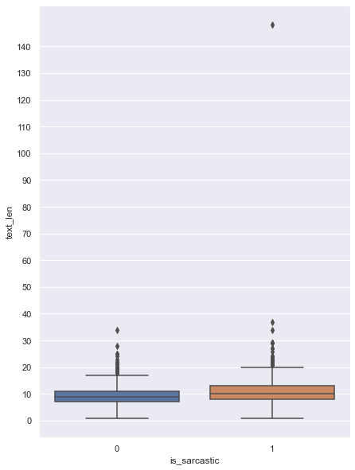
Length of Sentences

Slide 11
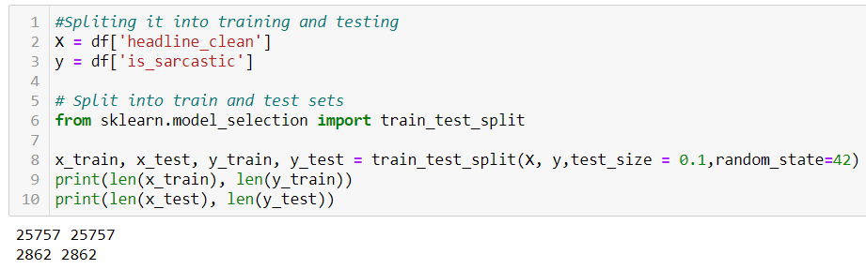
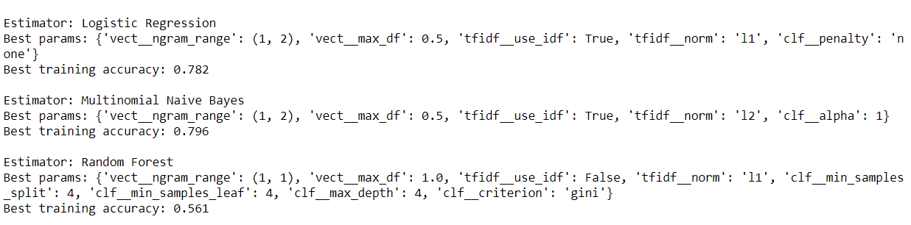
Splitting Dataset and Generating Training Score for Different Machine Learning Models

Slide 12
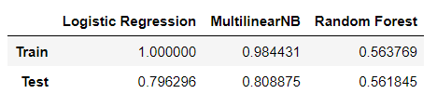
Comparing Results for Different ML Models

Slide 13
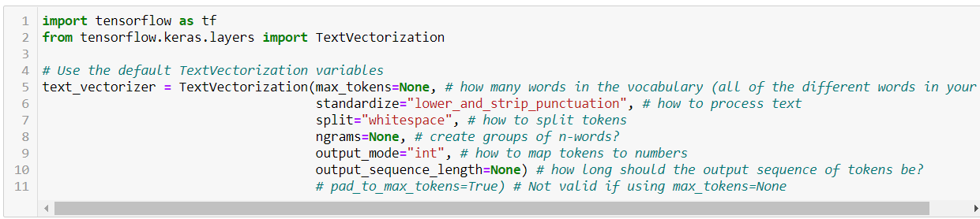
Deep Learning Models
We built our Deep Learning Models in separate notebook and environment to avoid any dependencies.
After Pre-processing the dataset, we split the dataset in Training and Validation sets.
To tokenize our words, we'll use the helpful preprocessing layer tf.keras.layers.experimental.preprocessing.TextVectorization

Slide 14

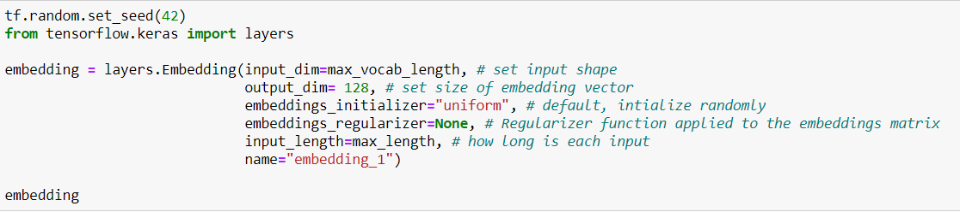
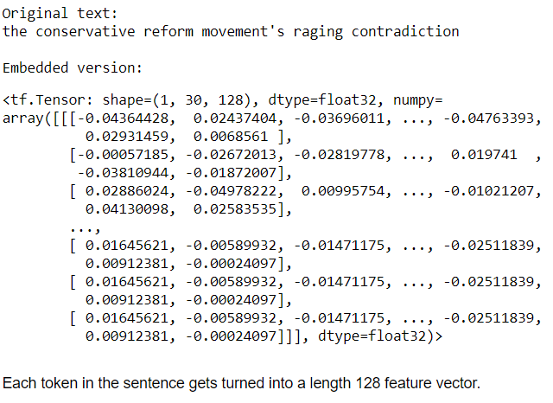
Creating an Embedding using an Embedding Layer
The powerful thing about an embedding is it can be learned during training. This means rather than just being static (e.g. 1 = I, 2 = love, 3 = TensorFlow), a word's numeric representation can be improved as a model goes through data samples. We can see what an embedding of a word looks like by using the tf.keras.layers.Embedding layer.

Slide 15
Baseline Model: Bidirectonal RNN model
LSTM stands for Long Short-Term Memory, is a Gated Recurrent Neural Network, and bidirectional LSTM is just an extension to that model. The key feature is that those networks can store information that can be used for future cell processing. We can think of LSTM as an RNN with some memory pool that has two key vectors:
(1) Short-term state: keeps the output at the current time step.
(2) Long-term state: stores, reads, and rejects items meant for the long-term while passing through the network.
In bidirectional LSTM, instead of training a single model, we introduce two. The first model learns the sequence of the input provided, and the second model learns the reverse of that sequence. Since we do have two models trained, we need to build a mechanism to combine both.
Why did we decided to use Bi-LSTM instead of LSTM?

Slide 16
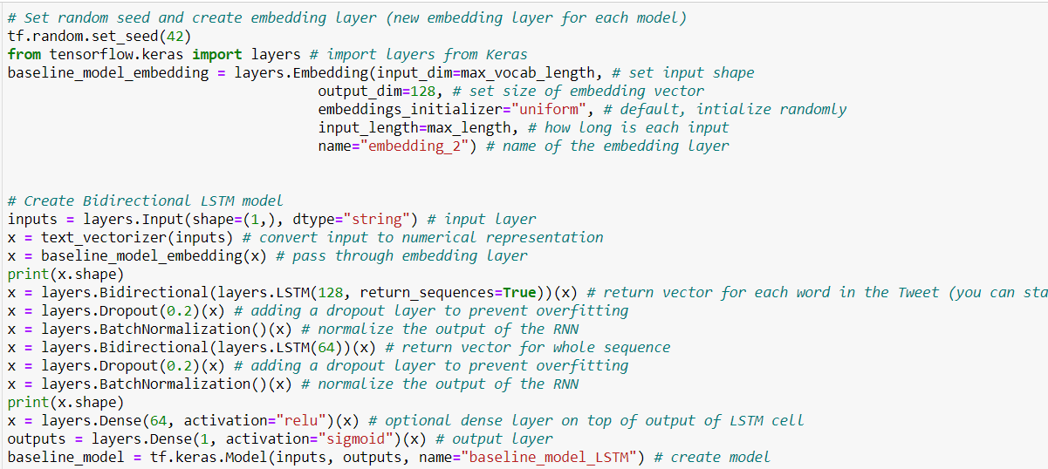
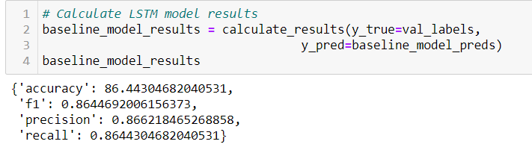

Slide 17
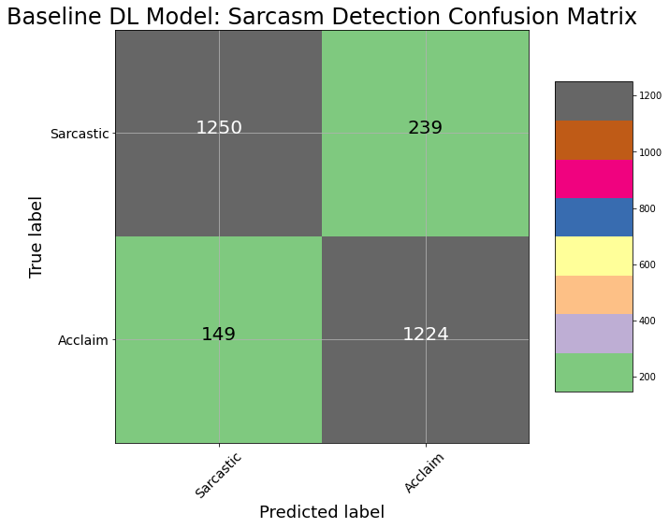
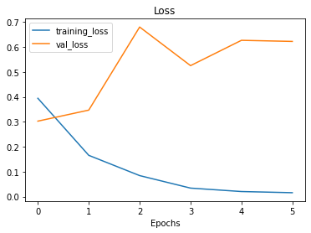
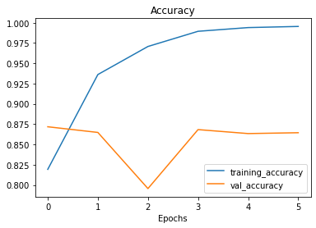

Slide 18
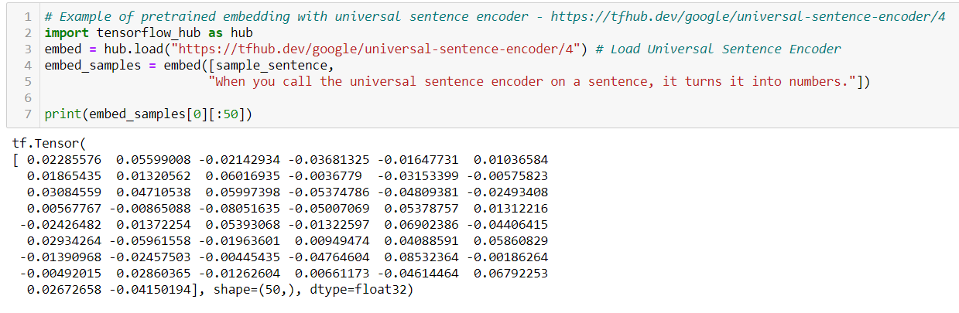
Modeling using Universal Sentence Encoder
The main difference between the embedding layer we created, and the Universal Sentence Encoder is that rather than create a word-level embedding, the Universal Sentence Encoder, as you might've guessed, creates a whole sentence-level embedding.

Slide 19
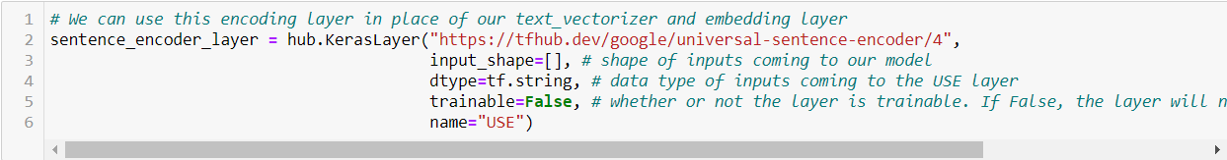
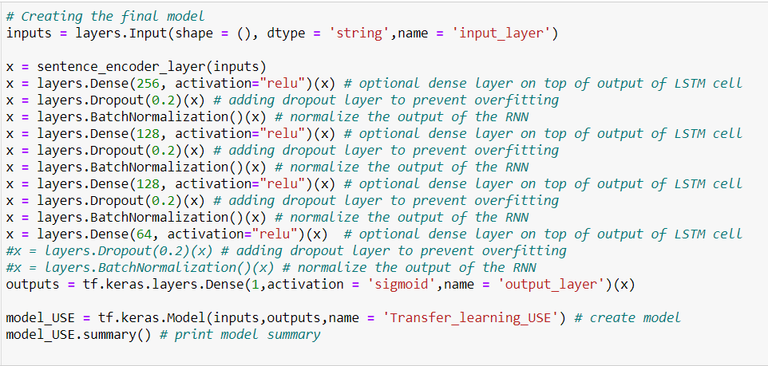

Slide 20
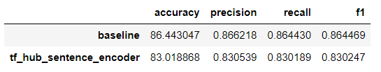
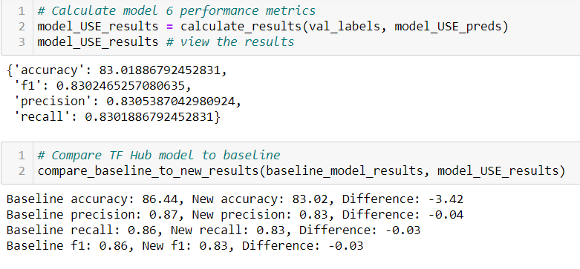
Evaluating our Models performance and comparing it with the Bi-LSTM baseline model

Slide 21
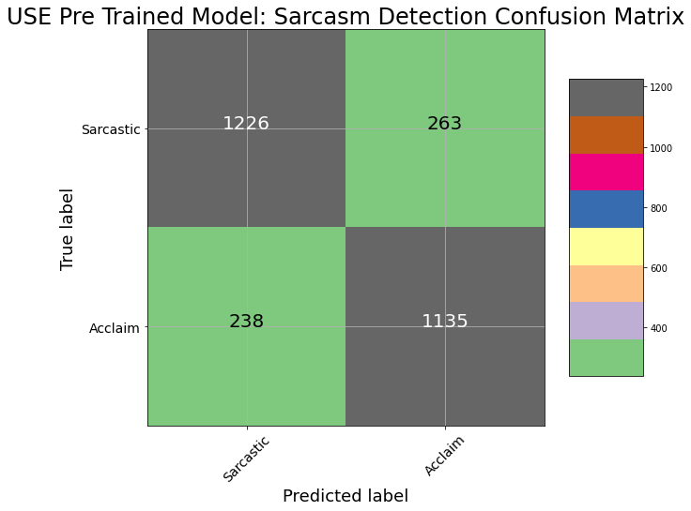
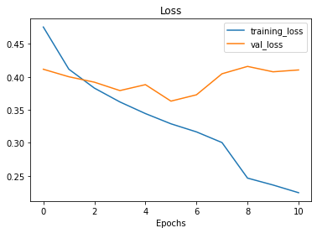
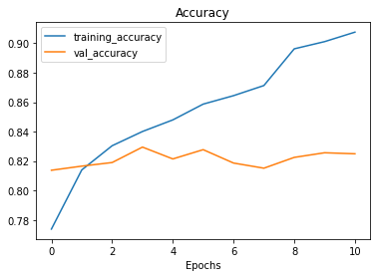

Slide 22
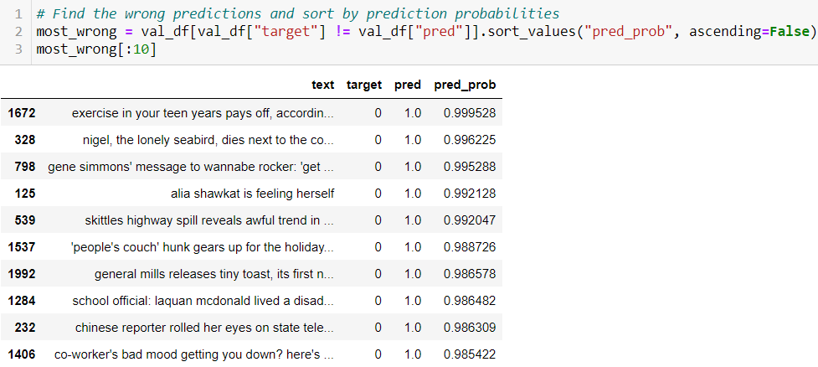
Our experiments
Finding the most wrong examples
We mentioned before that if many of our modelling experiments are returning similar results, despite using different kinds of models, it's a good idea to return to the data and inspect why this might be.
One of the best ways to inspect your data is to sort your model's predictions and find the samples it got most wrong, meaning, what predictions had a high prediction probability but turned out to be wrong.

Slide 23
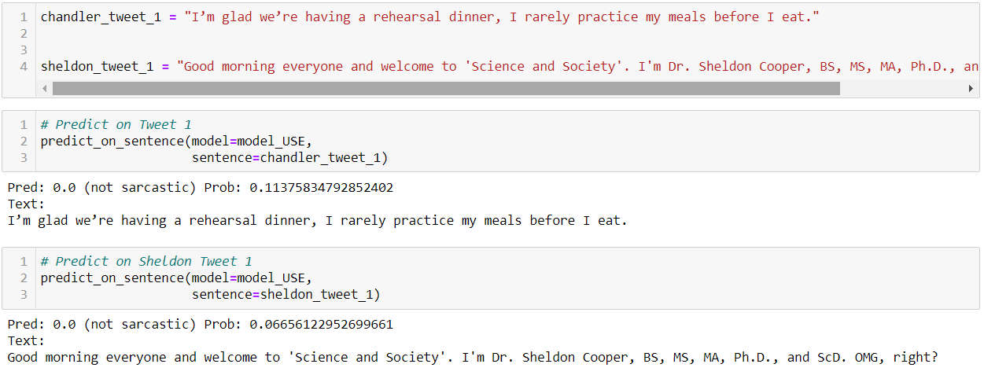

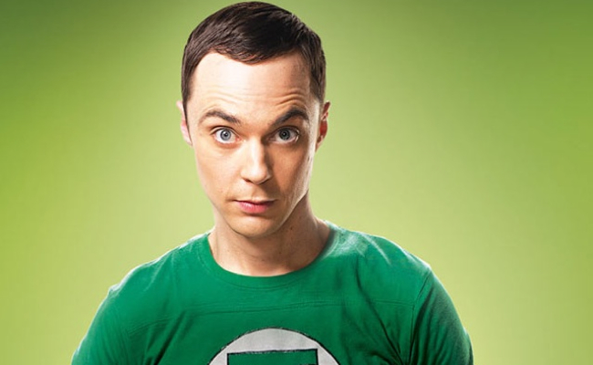
Making predictions on the new data

Slide 24

Thank You

